Slide 1
Using Active Listening to Identify Other’s Interests and Needs
Jennifer Poole, CPM
Idaho Industrial Commission Mediator

Slide 2
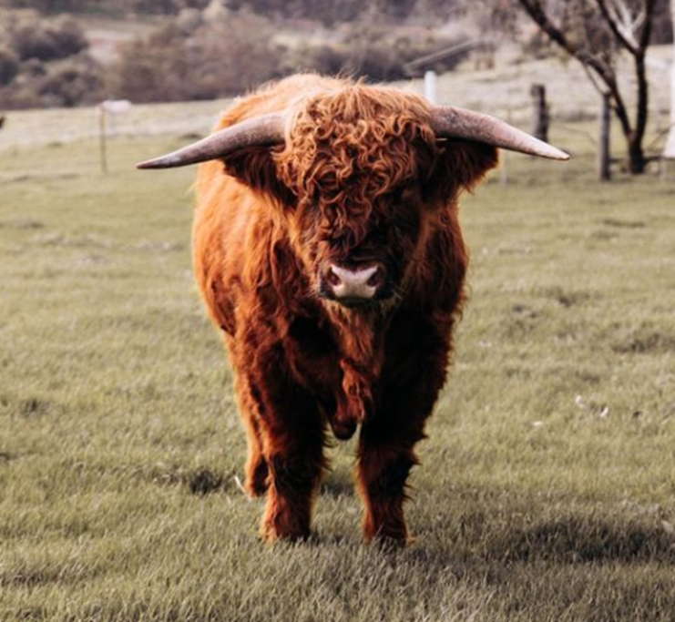
Pop Quiz
Are you
A Good
Listener?

Slide 3
Roadblocks
Controlling
Judging
Ignoring
Blaming
Patronizing
Why Questions
Advice Giving

Slide 4
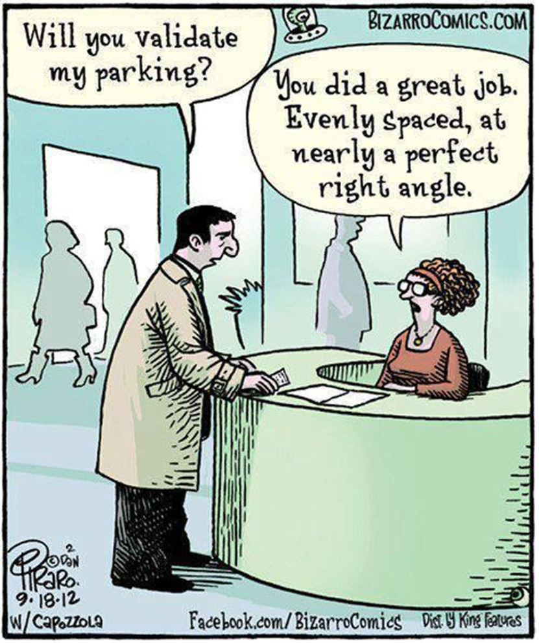
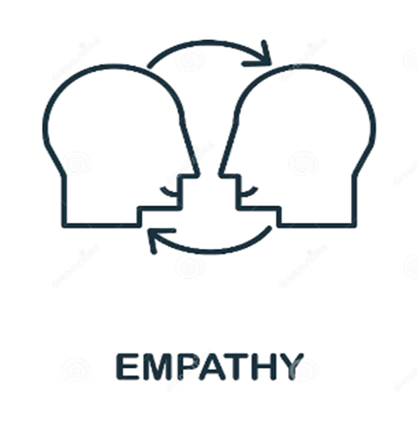
CRAVES

Slide 5
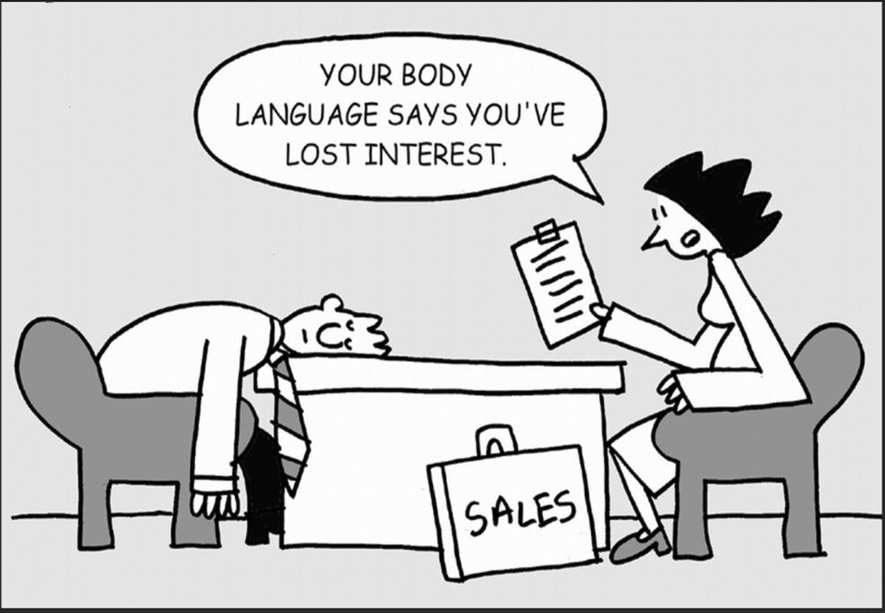
Kinesics
Facial area
Proxemics
Haptics
Paralanguage
Appearance
Chronemics
Nonverbals

Slide 6
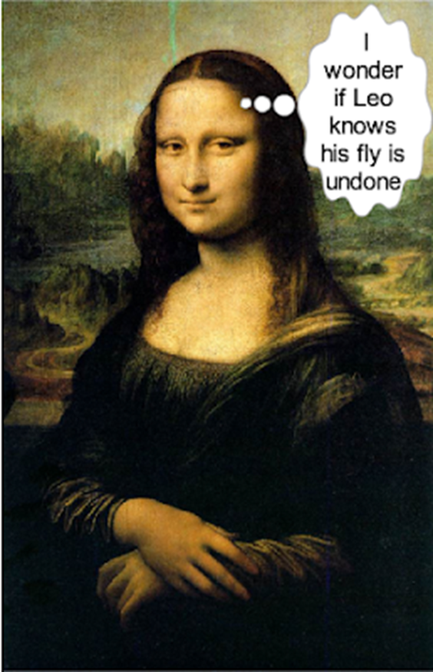
The Mona Lisa Smile
Paralanguage

Slide 7
Positions versus Interests
Positions -
Interests -
What you decided you want in a particular situation.
A specific solution.
What you want.
What caused you to decide.
The specific needs which cause you to take a particular position.
Why you want it.

Slide 8
What need is the person taking this position attempting to satisfy? What is motivating the person? What is the person trying to accomplish? What is the person afraid will happen if a demand is not fulfilled?

Slide 9
Position | Underlying Interest
Injured worker says - I am entitled to compensation. | ???
Injured worker says - I need this surgery.
Injured worker says - I can’t go back to work.
Employer says – I don’t think it should be an accepted claim.
Surety says – We want to settle out this claim.

Slide 10
Discussion/Questions?

