Slide 1

Claims
Advocacy
Dr. Claire Muselman

Slide 2

Dr. Claire Muselman
My mission in life is not merely to survive, but to thrive; and to do so with some passion, some compassion, some humor, and some style.
– Maya Angelou

Slide 3

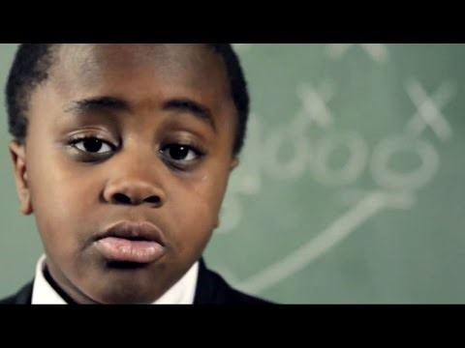
To Set The Tone…
The world needs you to stop being boring…
…BORING IS EASY!!
Create something that will make the world awesome!
– Kid President

Slide 4
Life lessons from a kindergartener…
Boring is easy…
If life is a game… aren’t we all on the same team?
I’m on YOUR team. Be on MY team!
Create something that will make the world awesome!
… I took the road less traveled.
“Don’t stop believing” unless your dream is stupid. - Journey
We can make every day better for each other.

Slide 5

What is happening in the world of insurance?
Global
United States
Personal
Commercial
Workers’ Compensation

Slide 6

What is happening in Workers’ Compensation?
Insurance Carriers
Employers
Friends/Family
Medical Providers
Attorneys

Slide 7
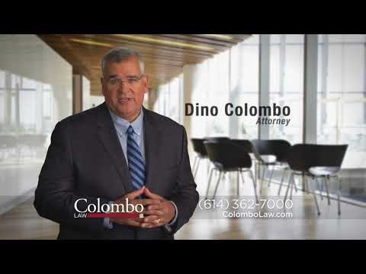

Messaging

Slide 8

And the favorite…

Slide 9

Messaging – Insurance Carriers

Slide 10
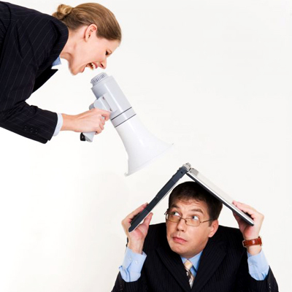
Messaging –
Employers

Slide 11

Messaging
–
Friends & Family

Slide 12

Messaging –
Medical Providers

Slide 13

Messaging
–
Attorneys

Slide 14


Why does it matter?
Emotional Hijacking
Biology
  Neocortex
  Limbic
Psychology
  Human Behavior
  Leadership Behavior
Maslow
  Needs
  Basics of WC
Physiology
  Stress
  Healing

Slide 15

Humans are complicated!
Remember: Behavior is:
Multi-faceted
Multi-functional
Multi-dimensional
Multi-emotional

Slide 16
What do you do about it?

Slide 17
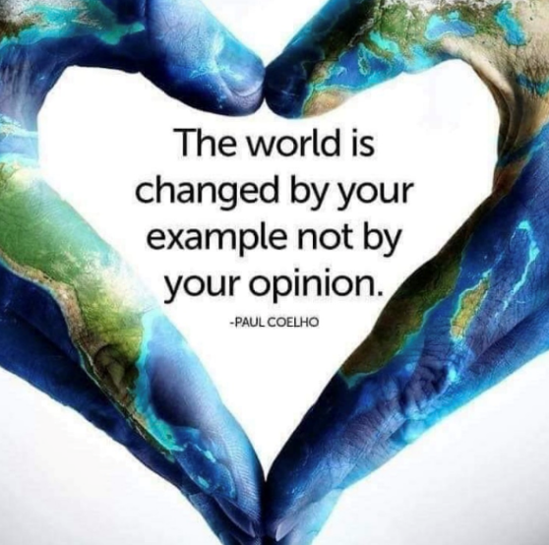
How does one bring upon change?

Slide 18

Do What you say you will do

Slide 19

Insurance Carriers & TPAs
Restore
the Livelihood of People
And if you work for an organization that does not…
You have TWO options.

Slide 20

Employers
Establish Accountability
Expectations
Post-Appointment Check Ins
Communication
Send cards
Text after injury
Care
Authenticity
Follow Up to Follow Though
Care about employees

Slide 21
The Gap
Go talk to HR
Restrictions
Human Connection

Slide 22
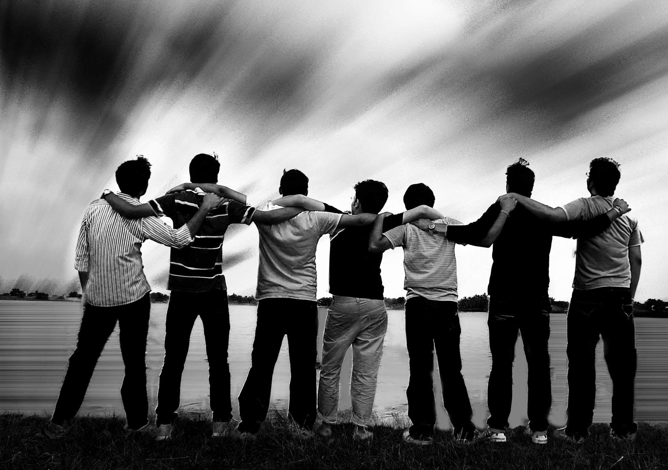
Friends & Family
People of Influence
Social Media

Slide 23
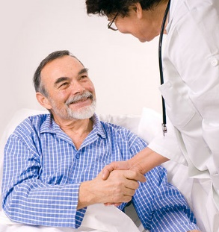
Medical Providers
Provide the Best Outcome
Background
Their perspective…

Slide 24
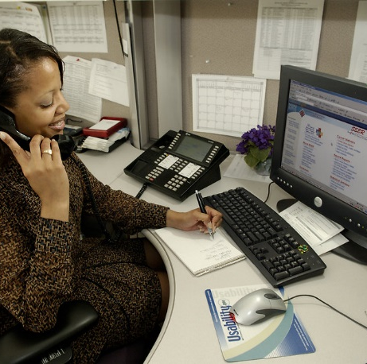
Adjusters
It costs nothing to be a good human. ☺
If your attitude does not reflect that of your organization... You have two choices.

Slide 25

What do you do about it?
Do What You Say You Will Do.

Slide 26
Remember
Change is made by your example.

Slide 27

Fraud
1.) Rohrlich, Ted and Evelyn Larrubia, "Anti-Fraud Drive Proves Costly for Employees." Los Angeles Times. Aug. 7, 2000. 2.)Leigh, J. Paul et al. Costs of Occupational Injuries and Illnesses. Ann Arbor: University of Michigan Press, 2000. pg. 195-197. 3.) David F. Utterback and Teresa M. Schnorr, “Use of Workers’ Compensation Data for Occupational Injury & Illness Prevention,” Department of Labor, 2010, www.cdc.gov/niosh/docs/2010-152/pdfs/2010-152.pdf. 4.) “Workplace Injury and Illness Summary,” Bureau of Labor Statistics, October 25, 2012, www.bls.gov/news.release/osh.nr0.htm. 5.) Quoted in Greg Hunter, “Worker’s Comp Scams that Push the Limits,” ABC News, March 3, 2013, http://abcnews.go.com/GMA/story?id=127996. 6.) Quoted in Selena Maranjian, “The Real Cost of Workers’ Comp Fraud,” Daily Finance, June 21, 2011, www.dailyfinance.com/2011/07/21/the-real-cost-of-workers- comp-fraud.

Slide 28
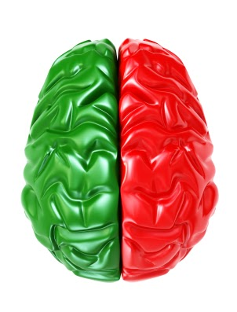
Emotional Hijacking
Emotional hijacking occurs when strong feelings overwhelm reason, judgment, and perspective.
  Thinking Brain
  +
  Feeling Brain
  = Behavior

Slide 29

Stress:
A neurological & physiological response triggered by a perceived threat.

Slide 30

Stress: causes us to run – neurological & hormonal responses

Slide 31

The stress cycle
What happens to our bodies?
Epinephrine – pushes blood into the muscles when we begin to feel stress.
(Thanks, hormones!)
Blood pressure & heart rate go up.
Muscles tense… breathing quickens.
Immunity decreases…
Growth, digestion & reproduction is slowed.

Slide 32
The stress cycle
DANGER~!
Chronic High Blood Pressure
Risk of Heart Disease
Compromised Immune System
Compromised Digestive System
Body WILL NOT Heal

Slide 33

Change the way you look at things… And the things you look at will change!

Slide 34

What if…

Slide 35
The Power of Influence

Slide 36
But Claire…Where do i start?
Send Cards to Injured Workers & Families
Establish Weekly Check-ins
Increase Communication & Transparency
Provide Consumable Education
Phrasing Recovery - Proactive, Caring Language
Provide a Vision
Focus on Psychosocial Issues

Slide 37

What if people had a good experience?
Would outcomes be different?
What if it were YOU?
The overall impact:
  Happy people
  Cost reduction
  Back to work, back to life

Slide 38
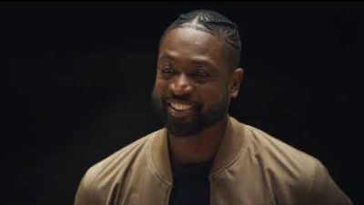
The world is changed by your example…

Slide 39
Take Away…
If you can wake up every morning
loving what you do
help & inspire other around you
to be better than they were yesterday
then you know
you’re doing something right
in business and in life.
- Ashley Bodi

Slide 40

Questions?
Go be awesome, and make good things happen for people.
After all…
Business is about people.

